Slide 1
Operating Systems
Chapter 9 Uniprocessor Scheduling

Slide 2
Agenda
9.1 Type of Processor Scheduling
9.2 Scheduling Algorithms
9.3 Summary

Slide 3
9.1 Type of Processor Scheduling
9.1.0 Overview
9.1.1 Long-term Scheduling
9.1.2 Medium-term Scheduling
9.1.3 Short-term Scheduling

Slide 4
Aim of Scheduling(调度目标)
Assign processes to be executed by the processor(s)(处理器分配)
Response time (响应时间)
Throughput (吞吐率)
Processor efficiency (处理器效率)

Slide 5
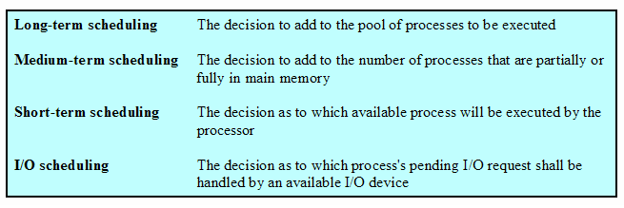
Types of Scheduling
Notes:
哪一个挂起进程的IO

Slide 6
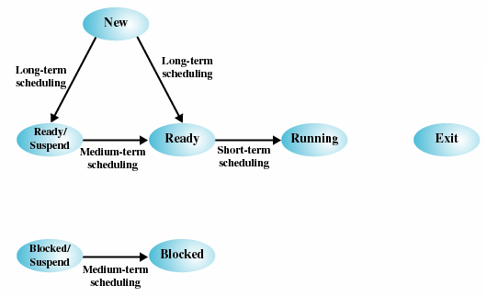
Scheduling and Process State Transitions(调度与进程状态转换)

Slide 7
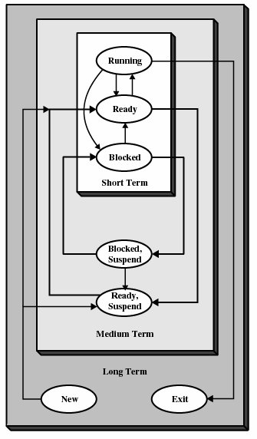
Levels of Scheduling(调度层次)

Slide 8
9.1 Type of Processor Scheduling
9.1.0 Overview
9.1.1 Long-term Scheduling
9.1.2 Medium-term Scheduling
9.1.3 Short-term Scheduling

Slide 9
Long-Term Scheduling (长程调度)
Determines which programs are admitted to the system for processing
Controls the degree of multiprogramming
More processes, smaller percentage of time each process is executed

Slide 10
9.1 Type of Processor Scheduling
9.1.0 Overview
9.1.1 Long-term Scheduling
9.1.2 Medium-term Scheduling
9.1.3 Short-term Scheduling

Slide 11
Medium-Term Scheduling (中程调度)
Part of the swapping function
Based on the need to manage the degree of multiprogramming

Slide 12
9.1 Type of Processor Scheduling
9.1.0 Overview
9.1.1 Long-term Scheduling
9.1.2 Medium-term Scheduling
9.1.3 Short-term Scheduling

Slide 13
Short-Term Scheduling (短程调度)
Known as the dispatcher(分派器)
Executes most frequently
Invoked when an event occurs
  Clock interrupts(时钟中断)
  I/O interrupts(I/O中断)
  Operating system calls(操作系统调用)
  Signals(信号)

Slide 14
Agenda
9.1 Type of Processor Scheduling
9.2 Scheduling Algorithms
9.3 Summary

Slide 15
9.2 Scheduling Algorithms
9.2.1 Short-term Criteria
9.2.2 The Use of Priorities
9.2.3 Alternative of Scheduling Policies
9.2.4 Fair-Share Scheduling

Slide 16
Short-Tem Scheduling Criteria(短程调度准则)
User-oriented(面向用户)
  Behavior of OS as perceived by the user (用户感知到的系统行为)
  E.g. Response Time(响应时间):Elapsed time between the submission of a request until there is output.
System-oriented(面向系统)
  Effective and efficient utilization of the processor(处理器的使用效率)

Slide 17
Short-Term Scheduling Criteria
Performance-related(性能相关)
  Quantitative 定量的
    Measurable such as
      response time(响应时间)
      throughput(吞吐率)
Not directly performance related(与性能无直接关系)
  Qualitative 定性的
    Unmeasurable such as
      predictability(可预测性)
Notes:
在实时系统中，可预测性十分重要，主要是通过可预测性提高系统的实时性

Slide 18
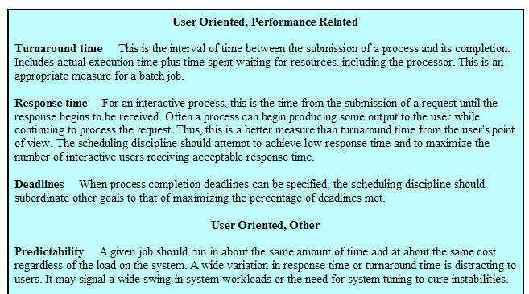
Scheduling Criteria
Notes:
周转时间，响应时间，最后期限；
可预测性，处理不稳定，差不多时间。

Slide 19
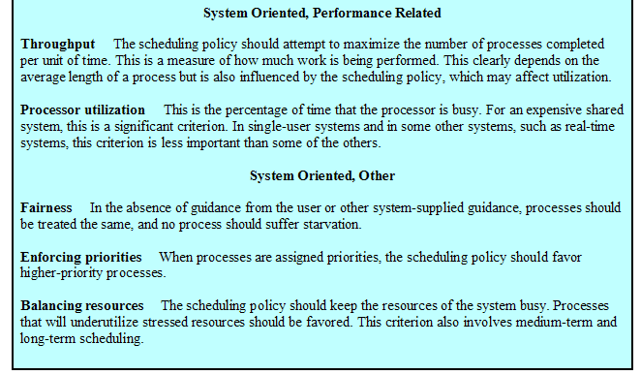
Scheduling Criteria (Cont.)
吞吐量
Notes:
in the absense of guidance from userr 在缺乏用户指导的情况下
吞吐量
处理机利用率
公平性，强制优先级，平衡资源 favored优先的；underutilize利用紧张资源不足的进程；

Slide 20
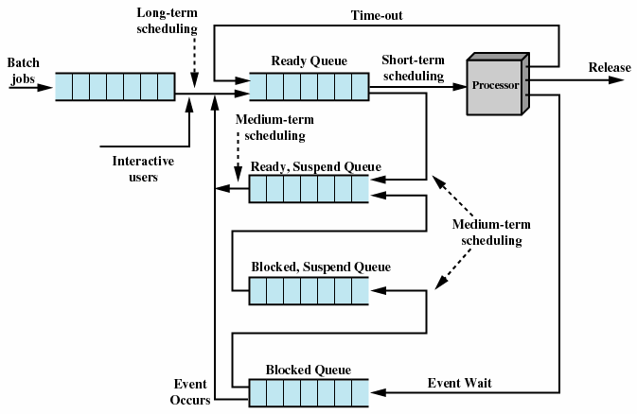
Queuing Diagram for Scheduling调度队列图

Slide 21
9.2 Scheduling Algorithms
9.2.1 Short-term Criteria
9.2.2 The Use of Priorities
9.2.3 Alternative of Scheduling Policies
9.2.4 Fair-Share Scheduling

Slide 22
Priorities(优先级)
Scheduler will always choose a process of higher priority over one of lower priority
Have multiple ready queues to represent each level of priority
Lower-priority may suffer starvation
  Allow a process to change its priority based on its age or execution history

Slide 23
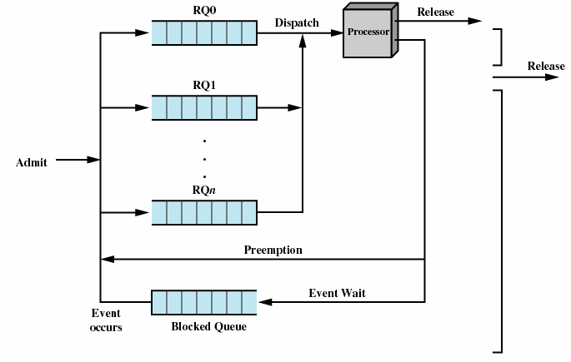
Priorities Queuing
Notes:
Preemption 抢占

Slide 24
9.2 Scheduling Algorithms
9.2.1 Short-term Criteria
9.2.2 The Use of Priorities
9.2.3 Alternative of Scheduling Policies
9.2.4 Fair-Share Scheduling
Notes:
选择调度策略

Slide 25
Terms
Response time(响应时间)
Turnaround time(周转时间)
Normalized turnaround time(归一化周转时间，周转时间/服务时间)
Throughput (吞吐率)
Predictability(可预测性)
Selection function(选择函数，确定在就绪进程中选择哪一个进程在下一次执行)
Decision mode(决策模式，选择函数被执行瞬间的处理方式)
  Preemptive (抢占，当前正在执行的进程可能被操作系统中断，并转移到就绪态)
  Nonpreemptive(非抢占，一旦处于运行态就不断执行直到终止或者被阻塞)

Slide 26
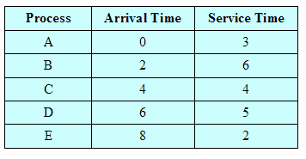
Process Scheduling Example

Slide 27
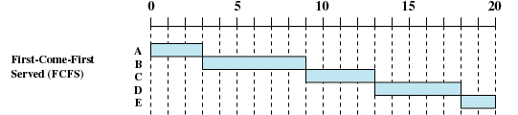
First-Come-First-Served (FCFS，先来先服务)
Decision mode: Nonpreempitive
Dispatch time: the current process ceases(终止) to execute
Method: The oldest process in the Ready queue is selected

Slide 28
First-Come-First-Served (FCFS)
Disadvantageous to short process
  A short process may have to wait a very long time before it can execute
Favors CPU-bound processes(偏向于受处理器限制的进程)
  I/O processes have to wait until CPU-bound process completes
Notes:
偏向于受处理器限制的进程；对于IO密集型进程不利

Slide 29


Round-Robin (RR，轮转)
RR，q＝1
Decision mode: preemption
Dispatch time: period q based on a clock
Method：select next process based on FCFS

Slide 30
Round-Robin
Clock interrupt is generated at periodic intervals
When an interrupt occurs, the currently running process is placed in the read queue
  Next ready job is selected based on FCFS
Known as time slicing (时间片)
Disadvantageous to I/O-bound processes
Notes:
不利于io频繁进程，不利于I/O绑定进程
在I/O调度中不能采用时间片轮转法的原因是很多输入/输出设备是独占设备，一经占用，占用进程便需一直到使用完该设备才能释放，从而无法轮转。

Slide 31
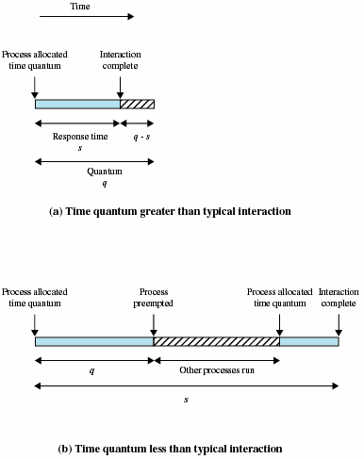
Effect of Size of Preemption Time Quantum (时间片大小的影响)
Notes:
时间片太大，变成了先来先服务，且内部可能会有浪费；时间片太小，频繁切换进程，切换代价；满足响应要求的合理值；

Slide 32
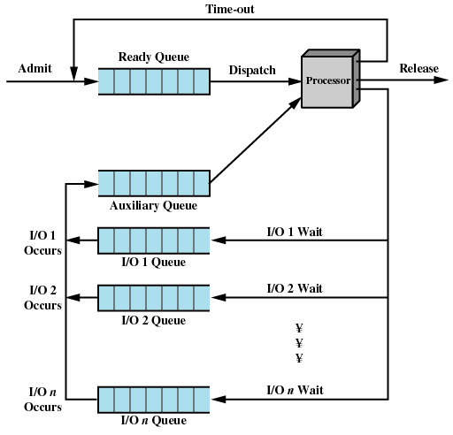
Queuing Diagram for virtual Round-Robin Scheduler (VRR，虚拟轮转法)
Notes:
虚拟轮转法：主要基于时间片轮转法进行改进，解决在CPU调度中对于I/O密集型进程的不友好。其设置了一个辅助队列，对于I/O型进程执行完一个时间片之后，则进入辅助队列，CPU调度时总是先检查辅助队列是否为空，如果不为空总是优先调度辅助队列里的进程，直到为空，才调度就绪队列的进程。

Slide 33

Shortest Process Next (SPN，最短进程优先)
Decision mode: Nonpreemptive
Dispatch time: the current process ceases to execute
Method: Process with shortest expected processing time is selected next
Notes:
ceases 停止执行，当前进程运行完毕后切换；短进程优先；属于非抢占式；

Slide 34
Shortest Process Next
Predictability of longer processes is reduced(长进程的可预测性降低了)
Possibility of starvation(饥饿) for longer processes

Slide 35

Shortest Remaining Time (SRT，最短剩余时间)
Decision mode: Preemptive version of shortest process next
Dispatch time: decision is made when a new process arrives
Method: Process with shortest remaining time is selected next

Slide 36

Highest Response Ratio Next (HRRN，最高响应比优先)
Decision mode: Nonpreemptive
Dispatch time: the current process ceases to execute
Method: Choose next process with the greatest response ratio
time spent waiting + expected service time
expected service time
R =

Slide 37
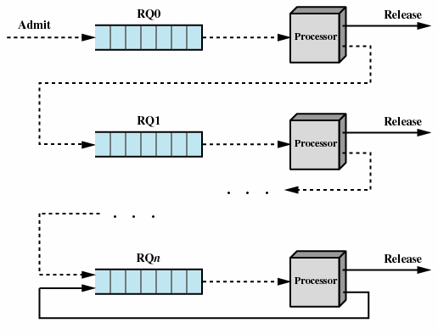
Feedback (反馈)
SPN/SRT/HRRN need to know process service time, while Feedback doesn’t
Preemptive
Penalize(惩罚) jobs that have been running longer

Slide 38
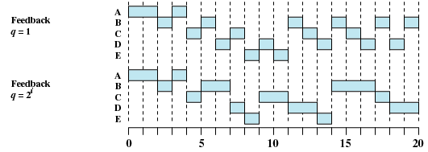
Feedback

Slide 39
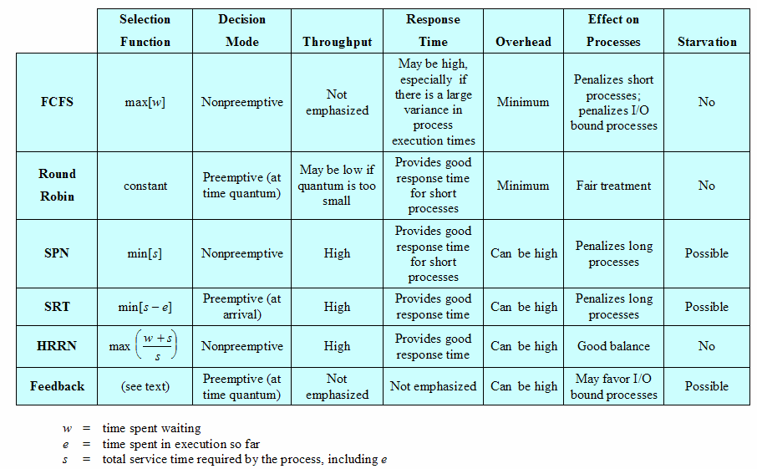
Characteristics of Various Scheduling Policies
Notes:
Overhead 开销

Slide 40
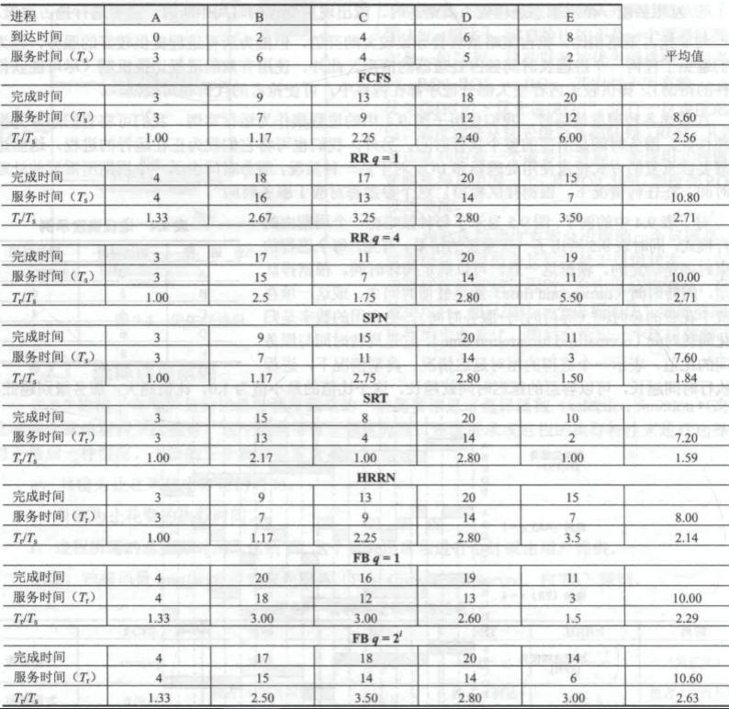
A Comparison of Scheduling policies

Slide 41
9.2 Scheduling Algorithms
9.2.1 Short-term Criteria
9.2.2 The Use of Priorities
9.2.3 Alternative of Scheduling Policies
9.2.4 Fair-Share Scheduling

Slide 42
Fair-Share Scheduling(公平共享调度)
User’s application runs as a collection of processes (threads)
User is concerned about the performance of the application
Need to make scheduling decisions based on process sets

Slide 43
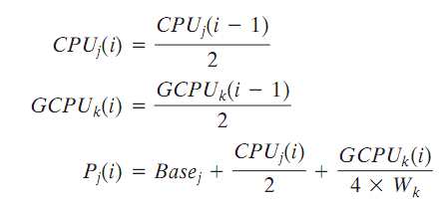
Fair-Share Scheduling(公平共享调度)
Scheduling is done on the basis of
  under-lying priority of the process
  recent processor usage of the process
  recent processor usage of the group
The higher the numerical value of the priority, the lower the priority. The following formulas apply for process j in group k:

Slide 44
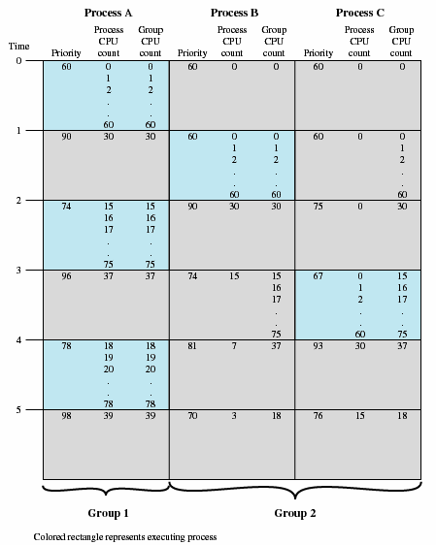
Example of Fair share Scheduler
Notes:
1：A:60+60/4+60/4=90; B=60+0+0；C=60+0+0;
2：A:60+30/4(取整数部分)+30/4(取整数部分)=74；B=60+60/4+60/4=90;C=60+0/4+60/4=75;
3: A:60+(15+60)/4+(15+60)/4=60+18+18=96; C=60+0/4+30/4=67;

Slide 45
Agenda
9.1 Type of Processor Scheduling
9.2 Scheduling Algorithms
9.3 Summary

